Slide 1


Slide 2

WELCOME TO
AMX Programmer III

Slide 3
Objectives
Program a complete master-to-master system using:
  Object Oriented Programming
  Arrays
  Data Structures
  UI and COMM modules
  Data Sets
  File Operations
  Marshalling
  Database Operations

Slide 4
Objectives
Use arrays to simplify programming
Use structures and marshalling to simplify master-to-master communications
Use virtual devices to communicate between modules
Learn techniques to reduce the code required to perform tasks
Understand and program database operations

Slide 5
Object Oriented Programming
Objects, Properties, and Methods
  An object is defined as: A runtime instance of some processing and values, defined by a static description called a “class.” It is a noun (person, place, or thing).
  Properties are adjectives that describe the noun.
  Methods are the actions that an object performs or the verbs describing actions the noun takes.

Slide 6
Object Oriented Programming
What makes a language Object Oriented?
  Encapsulation
    A principle, used when developing an overall program structure, that each component of a program should encapsulate or hide a single design decision.

Slide 7
Object Oriented Programming
What makes a language Object Oriented?
  Inheritance
    A mechanism for expressing similarity among Classes, simplifying the definition of Classes similar to one(s) previously defined.

Slide 8
Object Oriented Programming
What makes a language Object Oriented?
  Abstraction
    The principal of ignoring those aspects of a subject that are not relevant to the current purpose in order to concentrate on those that are.

Slide 9
Object Oriented Programming
What makes a language Object Oriented?
  Polymorphism
    The characteristic of being able to assign a different meaning or usage to something in different contexts - specifically, to allow an entity such as a variable, a function, or an object to have more than one form.

Slide 10
Is NetLinx an OOP Language?
NO!!!!
Our challenge is to apply object oriented analysis and design techniques to a non-object oriented language such as NetLinx.

Slide 11
Object Oriented Analysis & Design
Analysis means the process of determining the needs, or requirements, of a system – what the system must do, but NOT how the system does it.
Object oriented design is defined as the practice of taking a specification (done using OOA hopefully) of externally observable behavior and adding details needed for actual computer system implementation, including human interaction, task management, and data management details.

Slide 12
Object Oriented Design
There are four components/activities in OOD:
  Designing the Problem Domain
  Designing the Human Interaction
  Designing the Task Management
  Designing the Data Management

Slide 13
Object Oriented Design
Designing the Problem Domain
  This activity involves making sure all the objects in the system have been defined properly in the OOA phase. In our industry it involves selecting the right control devices to control the A/V equipment.
Designing the Human Interaction
  This activity in the A/V world is mostly the touch panel or other input panel type, including PC input.

Slide 14
Object Oriented Design
Designing the Task Management
  Tasking simplifies the design and code of needed concurrent behavior. In NetLinx, tasks are implemented in an Event, Function, or Subroutine. In the OOD phase, the Event, Function, or Subroutine is identified, but no code is written to implement it.
Designing the Data Management
  This is where you determine your data needs. Do you need an external database? How about storing data in files on the master? Do any variables need to be persistent? Should you use individual variables or a structure for some data? What variables need to have system wide, file, or local scope? How big do your arrays need to be? These are some of the things to be considered in this component.

Slide 15
Mapping OOD to NetLinx
The challenge now becomes taking the objects, with their properties and methods, and implementing the design in NetLinx. This is not as easy as it would be in a truly object oriented language such as Visual C++ or JAVA, since NetLinx is not an object oriented language.
What we need to learn is how to create “Classes”, and objects with their properties and methods in Netlinx. We also need to learn how to implement inheritance, encapsulation, and polymorphism in NetLinx.

Slide 16
Mapping OOD to NetLinx
First, we can create a “Class” as a module in NetLinx. The module will model an object of that “Class”. We instantiate, or create an instance of, an object by calling that module in the “Main” source code file.
We can simulate inheritance by calling another module within a “Primary” module. For example:
  “Primary” module = VCR
  “Inherited” module 1 = RS232 Controlled VCR
  “Inherited” module 2 = IR Controlled VCR

Slide 17
Mapping OOD to NetLinx
The module abstracts and encapsulates the data and methods for a particular object.
Properties of an object are the variables defined in the DEFINE_VARIABLE section of a module or in a structure defined in that module.
Methods for an object are written as events, such as BUTTON_EVENTS, DATA_EVENTS, etc. in the DEFINE_EVENT section of the module.

Slide 18
Mapping OOD to NetLinx
One of the major drawbacks to using modules in this manner is that code in modules run in the same thread.

Slide 19

Questions & Answers

Slide 20
Using Arrays
Integer arrays that contain button channel codes
Device arrays containing devices that are to be combined
Arrays containing the sources connected to switcher inputs
Arrays containing the destinations connected to switcher outputs
Arrays containing IR codes
Arrays containing RS-232 codes

Slide 21
Using Arrays
Relationship between button channel codes in an array and IR or RS-232 codes in an array
Relationship between sources in an array and the input channel on the switcher to which they are connected
Relationship between destinations in an array and the output channel on the switcher to which they are connected

Slide 22
Questions & Answers

Slide 23
Variable Scope
Local
File
New - System

Slide 24
Modules
The naming convention of a module is ‘MFG_MODEL_<type>’
  Type would be a classification of module such as COMM (Communication) or UI (User Interface).
  There could be different UI <types> based upon each device being controlled.

Slide 25
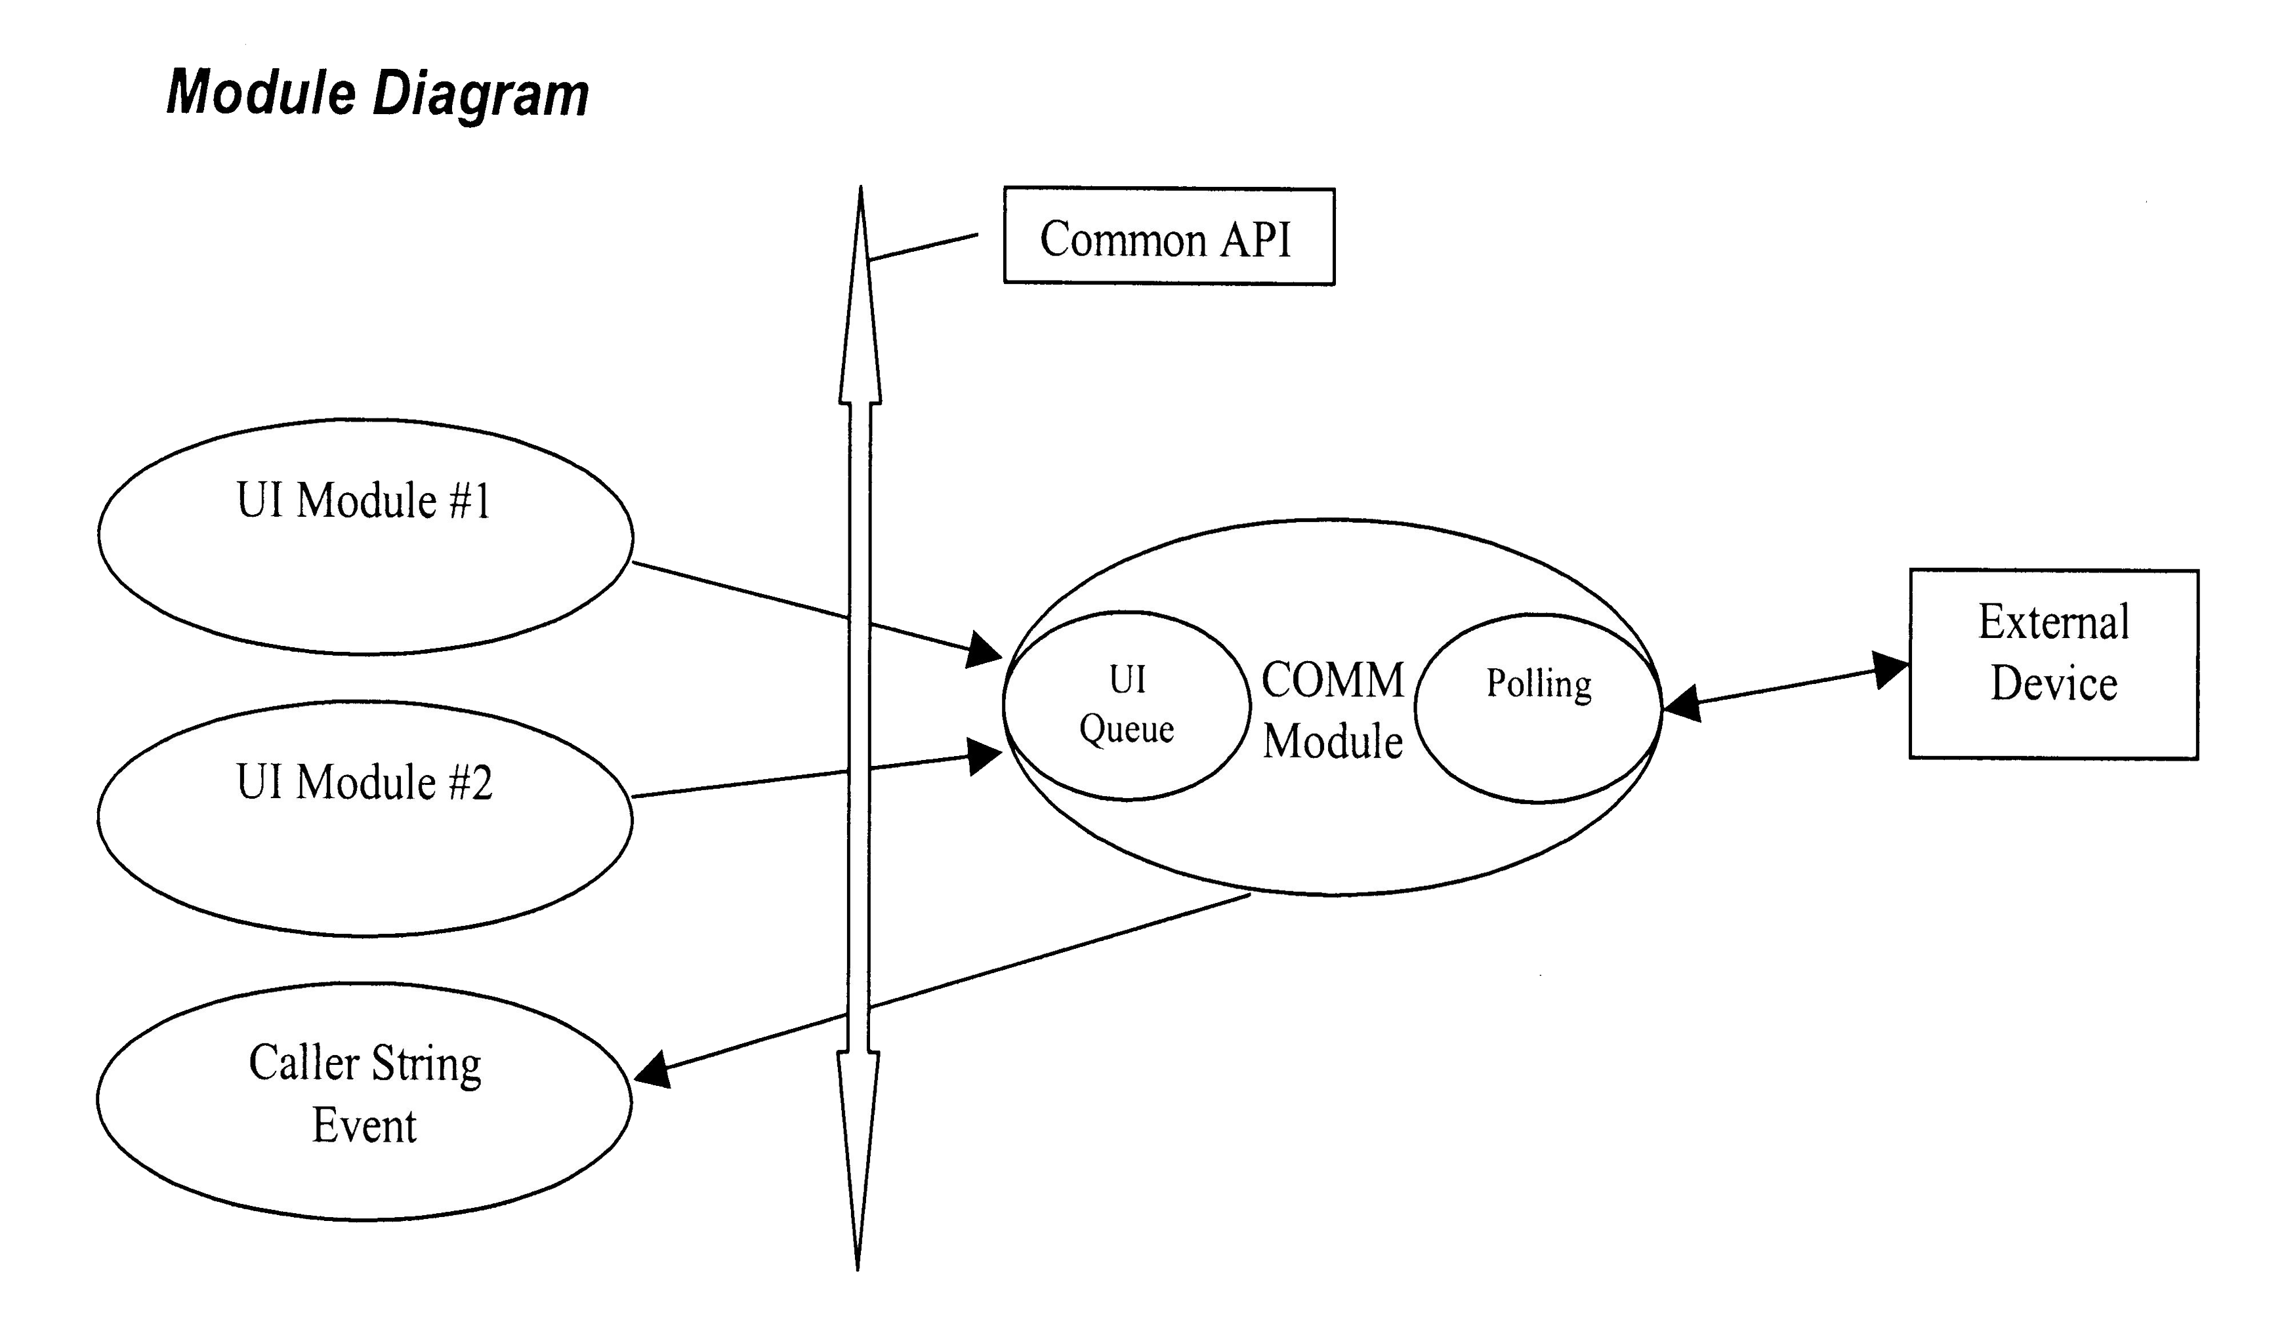
Modules
UI modules communicate with COMM modules and vice-versa through a common API

Slide 26
Modules
Application Programming Interface (API)
  The API exposes the methods that a COMM module uses to control a device
  The UI module calls these methods using the API
  The API should simplify UI programming by hiding the complexity of controlling the actual device
API Strategies
  Channels: COMM module methods are called by pulsing channels on virtual devices
  Strings: COMM module methods are called by sending strings to virtual devices

Slide 27
Modules
Implementing API Strategies
  “Brute Force” Method: Write a button event for each button on the touch panel and pulse the virtual channel or send a string to the virtual device for the corresponding API function
  Array Method: Create arrays to hold the touch panel button channel codes, API channel codes or ASCII commands, and device specific control codes. Place all the codes in corresponding positions in each array and use GET_LAST to get the index into each array.
  Levels: Use levels on the virtual device to send data that can have a range of values such as volume, brightness, contrast, lighting levels, etc.

Slide 28
Modules
Some modules may require large parameter lists
  Button channel arrays
  Command arrays
Create an include file where all of these parameters are defined.
  This include file should also contain the definition of the modules.
  This AXI file would typically be included after the DEFINE_DEVICE section of the caller’s NetLinx program.
  Within the AXI file, the module definitions typically would come after the DEFINE_START section.
  Other parameter lists may be within the DEFINE_VARIABLE section.

Slide 29
Modules
Some UI modules may allow the caller to enter a NO BUTTON condition
  This means this UI doesn’t require the functionality of the button.
  In system calls, NO BUTTON is defined as 0.
  In NetLinx, using 0 under a button event provides the functionality that ALL pushes will iterate through the button event, regardless of whether they are included in the DEVCHAN or INTEGER button array.
  This could be undesirable, since all pushes would iterate through any button events that had 0 as a channel.

Slide 30
Modules
All common module definitions should be included one after the other.
  All COMM modules grouped together then all UI modules grouped together.

Slide 31
COMM Modules
COMM modules communicate with the external devices.
  They typically require at least 2 parameters
    virtual device
    actual device.
  A COMM module will do all of the buffer parsing, device polling, and device control that may be required.
  A COMM module will use the virtual device to expose feedback, levels, send strings (for controlling the external device), and string events (for getting data back from the the device).

Slide 32
COMM Modules
The COMM module should always queue up the commands when necessary.
  That way the caller could stack several commands and expect the module to execute them without any knowledge of the delays required to make all of the commands go out.

Slide 33
UI Modules
The UI module is the User Interface between the touch panel and the actual device.
The parameter list typically contains a DEV type touch panel, the virtual device, and groups of INTEGER arrays for channel codes and variable text.
When multiple panels are required to control the same device, it is up to the caller to determine whether the main NetLinx program should combine devices and pass a virtual device in as the touch panel, or whether multiple calls to the same UI module with different panels (parameters) will be needed.

Slide 34
UI Modules
The UI will be custom for each external device.
Some devices may require multiple UI modules.
  Such as a combo deck (DVD/CD). You may have one UI for the DVD functions and one UI for the CD functions.
These UI modules will communicate with the COMM module through the API.

Slide 35
Module Caveats
One of the major problems with modules in that code in modules run in the same thread.
  If one module calls a routine in another module, the code in the first module will continue to execute and when it finishes, the code in the 2nd module will execute.
  This can lead to timing issues.

Slide 36
Module Caveats
A bug in the NetLinx compiler causes problems if you try to make any device, channels Mutually Exclusive in a module.
  You must declare all device, channels Mutually Exclusive in the Main program.
If you are using multiple modules there can be a problem if you have WAIT statements in different modules.
  Use TIMELINEs in modules rather than WAIT statements

Slide 37
Questions & Answers

Slide 38
Structures
Where do you use structures?
  COMM modules
  Master-to-Master communication
Why do you use structures?
  Group all of a device’s properties in one element
  Makes it easier to debug
  Pass all of a device’s properties from one module to another or from one master to another master
  Usually more efficient use of memory than multi-dimensional arrays
  Used as XML schemas for database and other applications

Slide 39
Questions & Answers

Slide 40
File Operations
Opening and Closing Files
  FILE_OPEN(’textfile.txt’,2)
  FILE_CLOSE(FileHandle)
Reading and Writing Files
  FILE_READ & FILE_READ_LINE
  FILE_WRITE & FILE_WRITE_LINE
Copying, Deleting, and Renaming Files
Directory Management
Error Checking

Slide 41
Questions & Answers

Slide 42
Marshalling Concepts
There are six special functions used to encode and decode variables in NetLinx
There are two version of this encoding and decoding: Binary and XML. The binary conversion routines are:
  STRING_TO_VARIABLE
  VARIABLE_TO_STRING
  LENGTH_ VARIABLE_TO_STRING.
The XML conversion routines are:
  XML_TO_VARIABLE
  VARIABLE_TO_XM
  LENGTH_ VARIABLE_TO_XML

Slide 43
Marshalling Concepts
This encoding process takes a NetLinx variable, no matter how complex, and converts it into a string.
  Once the variable exists in string form, it can then be sent across an RS-232 connection, sent over an IP socket or saved to the NetLinx master's file system (disc on chip).
The decode process will take this string and copy the contents back into a variable.
  Once the string is retrieved, either from a data event or by reading the information from the NetLinx master's file system, the data can be converted back to a variable.

Slide 44
Questions & Answers

Slide 45
DEV Sets
Used to Combine Devices
  Commands executed on the array affect all devices in the array
    PULSE [dvRelayArray,3]
  Use array index to execute commands on individual devices in the array
    PULSE [dvRelayArray[2],3]
Used to simplify code

Slide 46
DEV Sets
Example –
DEFINE_VARIABLE
DEV dvVCRs[] = {dvVCR1,dvVCR2,dvVCR3} //Devices defined in DEFINE_DEVICE section
INTEGER nVCRSources[] = {19,24,98} //Select a source btn channels
INTEGER nTransportCtls[] = {32,46,25,89,56} //Play,stop,etc btn channels
INTEGER nVCR //The last VCR selected
DEFINE_EVENT
BUTTON_EVENT[dvTPs,nVCRSources] {
PUSH:
{
nVCR = GET_LAST(nVCRSources)
} }
BUTTON_EVENT[dvTPs,nTransportCtls] {
PUSH:
{
PULSE [dvVCRs[nVCR],GET_LAST(nTransportCtls)]
} }
Notes:
DEFINE_VARIABLE
//Devices defined in DEFINE_DEVICE section
DEV dvVCRs[] = {dvVCR1,dvVCR2,dvVCR3}
//Select a source btn channels
INTEGER nVCRSources[] = {19,24,98}
//Play,stop,etc btn channels
INTEGER nTransportCtls[] = {32,46,25,89,56}
INTEGER nVCR
INTEGER nVCRfb[3] //Make array size = to number of devices in source array
INTEGER x //Loop counter
DEFINE_EVENT
BUTTON_EVENT[dvTPs,nVCRSources]
{
PUSH:
{
nVCR = GET_LAST(nVCRSources)
}
}
BUTTON_EVENT[dvTPs,nTransportCtls]
{
PUSH:
{
PULSE [dvVCR[nVCRs],GET_LAST(nTransportCtls)]
}
}
DEFINE_PROGRAM
FOR (X=1;X<=LENGTH_ARRAY(nVCRSources);X++)
{
[dvTPs,nTransportCtls[X]] = (nVCRfb[nVCR] == x)
}

Slide 47
Questions & Answers

Slide 48
Master-to-Master
Three Components
  Devices defined in the DEFINE_DEVICE section
  URL lists
  Variable synchronization
    Virtual devices
      Send String
      Send Command
      Structures and Marshalling
      Channels

Slide 49
Questions & Answers

Slide 50
Database Operations
DatabasePlus Wizard
  This application acts as the foundation for the other database applications. The functions and subroutines contained within the i!-DatabasePlus ASP and NetLinx include files are used in the i!-CDList, i!-NetDial, and other applications.
DBWizard enables you to specify a database, queries, and file locations, and generates an ASP file and a NetLinx Include file that imports the specified data into your NetLinx program.

Slide 51
Database Operations
DatabasePlus uses a Microsoft Web Server to interact with ODBC compliant databases.
Microsoft Internet Information Server or Personal Web Server must be accessible to the NetLinx Master.
The NetLinx Program passes SQL queries to the Web Server as CGI strings, and parses XML responses generated by ASP scripts.

Slide 52
Database Operations
The NetLinx AXI file generated by the DBWizard provides the basic framework for interacting with databases.
The AXI file creates the device, which connects to the Web Server, and creates the structures and variables that are used to store the retrieved data.

Slide 53
Database Operations
The members of the structure are given the names of the database fields selected in DBWizard with the Hungarian Notation prefixes for their data types.
A container array is created for the structure with the number of elements provided by the Page Size field on the Queries Tab of DBWizard.

Slide 54
Database Operations
DBWizard creates four functions for you to use without needing any modifications:
  Read
  Add
  Edit
  Delete
DBWizard creates a fifth function that you modify to fit your application:
  Display

Slide 55
Database Operations
Built-in structure variables defined:
  .nCOUNT = current number of records in structure. Always less than or equal to .nDISPLAY_SIZE
  .nDISPLAY_SIZE = the number of records you can display on your touch panel at one time.
    Same as the Page Size you specify in DBWizard.
  .snFIRST = the record number of the first record displaying on your touch panel
  .snLAST = the record number of the last record displaying on your touch panel
  .snTOTAL = the total number of records in your database

Slide 56
Questions & Answers

Slide 57

Thank you for attending!
Please complete the class survey.

